Slide 1
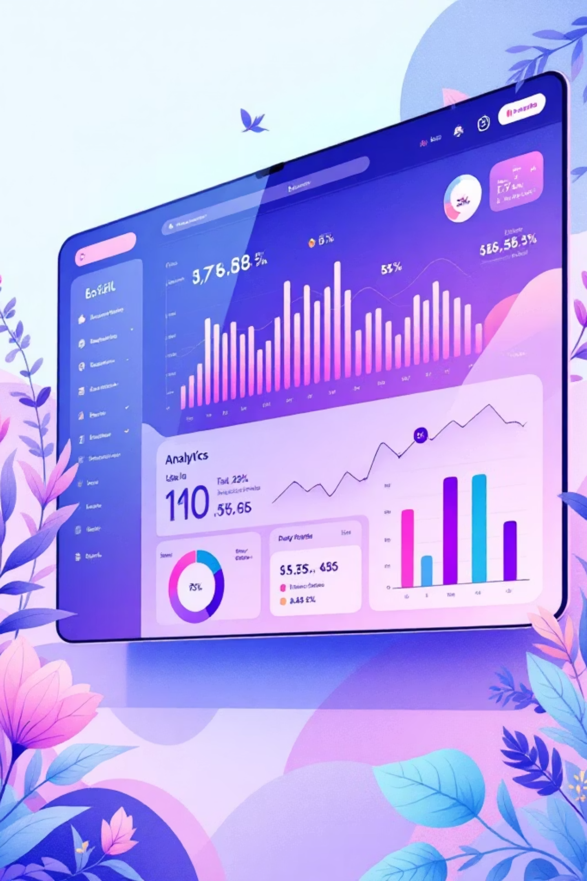
Customer Shopping Behavior Analysis
Uncovering insights from 3,900 purchases to drive strategic decisions

Slide 2
OVERVIEW
Dataset at a Glance
3.9K
18
4
Total Purchases
Data Features
Product Categories
Key Data Points
Customer demographics & purchase history
Product preferences & seasonal trends
Subscription & discount behavior
Review ratings & shipping choices

Slide 3

PYTHON ANALYSIS
Data Preparation & Cleaning
01
Data Loading
Imported dataset using pandas, explored structure
02
Missing Data
Imputed 37 missing review ratings by category median
03
Feature Engineering
Created age groups & purchase frequency columns
04
Database Integration
Loaded cleaned data into PostgreSQL for analysis

Slide 4

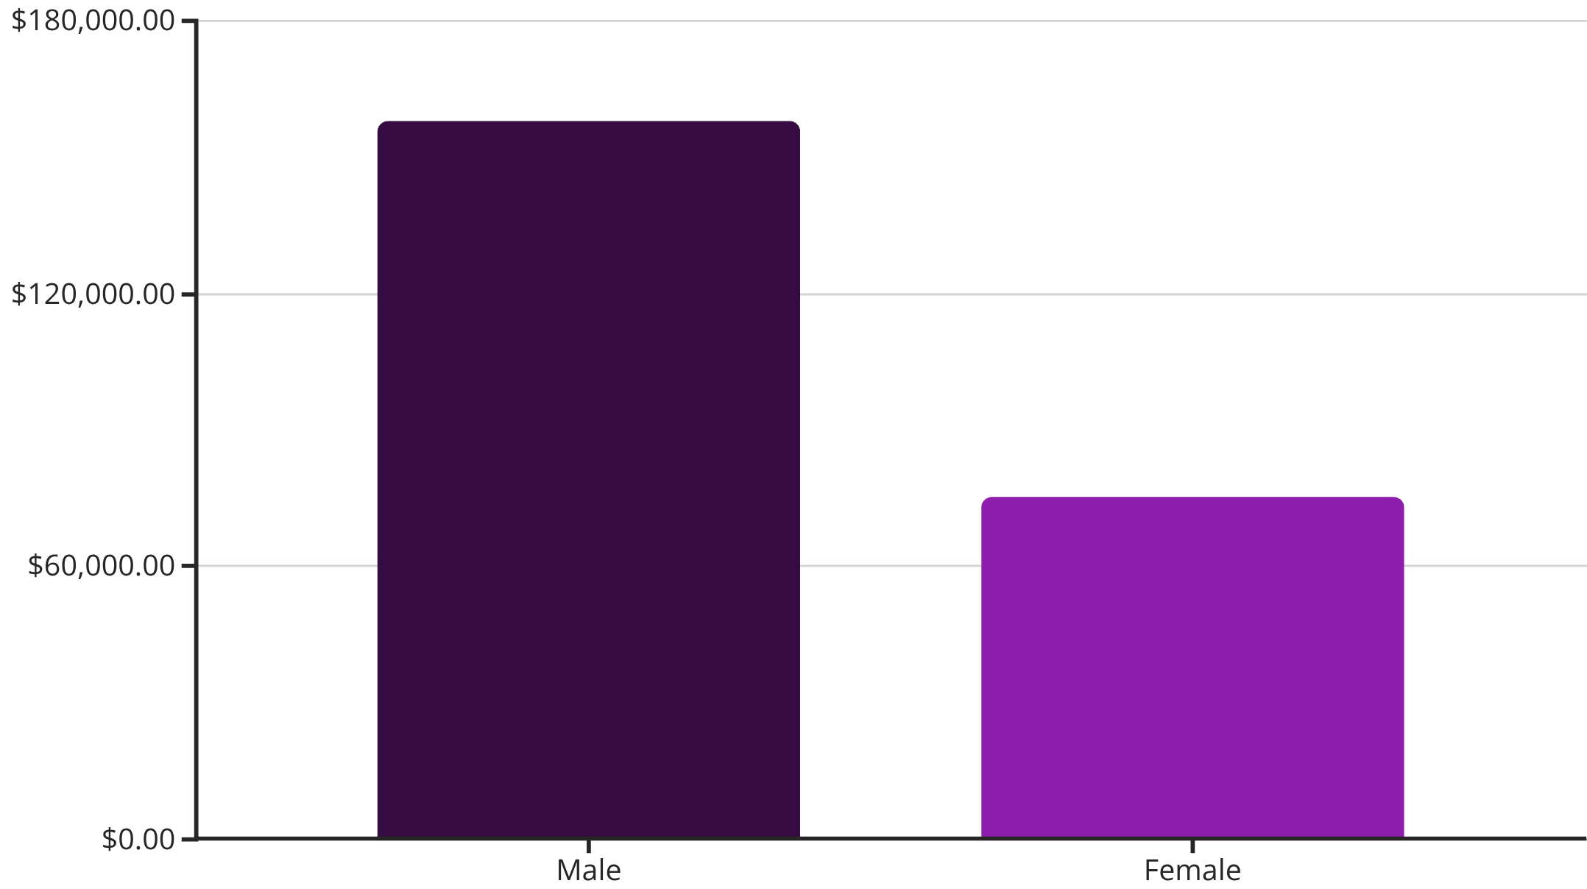
SQL INSIGHTS
Revenue by Gender
Key Finding
Male customers generate 2.1x more revenue than female customers, representing a significant opportunity for targeted marketing.

Slide 5
Top-Rated Products
3.86
3.84
3.82
Gloves
Sandals
Boots
Highest average rating
3.80
3.78
Hat
Skirt

Slide 6

CUSTOMER SEGMENTS
Loyalty Distribution
Segment Breakdown
Customer classification based on purchase history reveals strong loyalty base.
New
83 customers
Returning
701 customers
Loyal
3,116 customers

Slide 7
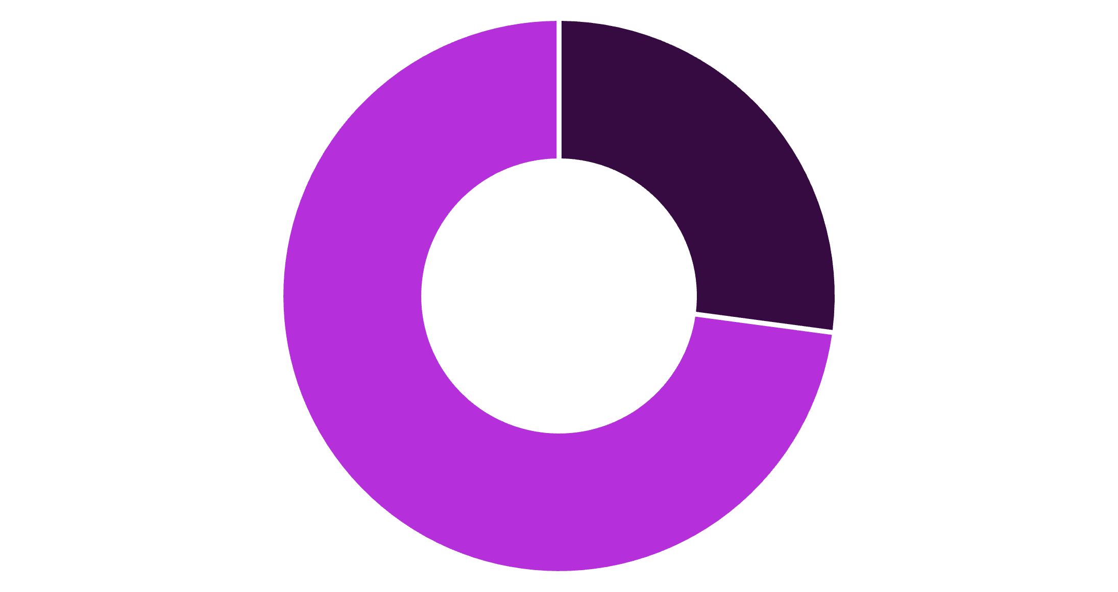
Subscription Analysis
Subscription Opportunity
Only 27% subscribe despite similar spending patterns
Massive untapped potential for subscription growth
Subscribers
Non-Subscribers
Subscribers: $59.49 avg spend
Non-Subscribers: $59.87 avg spend

Slide 8




Revenue by Age Group
Young Adult
Middle-aged
Adult
Senior
$62K revenue • 1,028 customers
$59K revenue • 986 customers
$56K revenue • 942 customers
$56K revenue • 944 customers

Slide 9
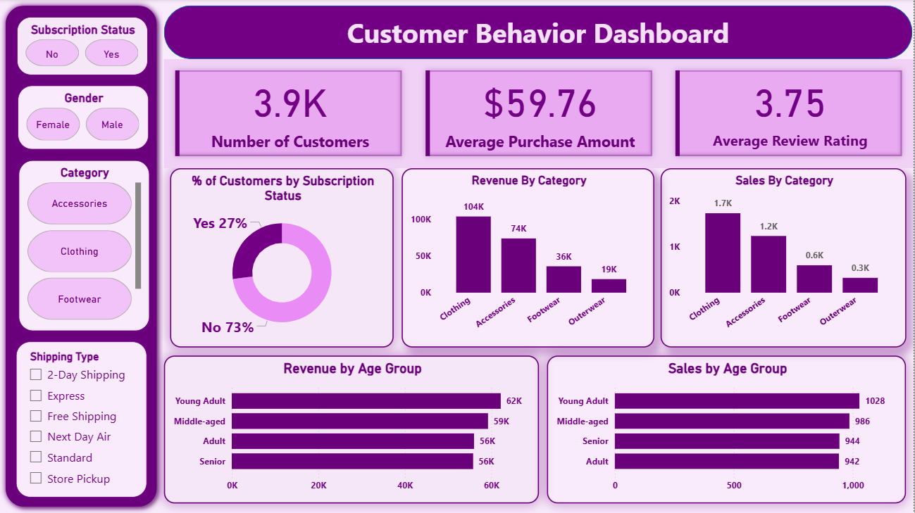

POWER BI DASHBOARD
Interactive Analytics Platform
Real-time insights across subscriptions, categories, shipping, and demographics

Slide 10





ACTION ITEMS
Strategic Recommendations
Boost Subscriptions
Loyalty Programs
Optimize Discounts
Promote exclusive benefits to convert 73% non-subscribers
Reward repeat buyers to expand loyal segment
Balance sales boosts with margin control
Targeted Marketing
Product Positioning
Focus on high-revenue age groups & express shipping users
Highlight top-rated items in campaigns

